Slide 1




Macrosystems EDDIE: Exploring Tradeoffs in Water Quality Management Using Environmental Data
Lofton, M.E., Cooke, R.L., and Carey, C.C. 20 September 2025.
Macrosystems EDDIE: Exploring Tradeoffs in Water Quality Management Using Environmental Data.
Macrosystems EDDIE Module 10, Version 1.
https://serc.carleton.edu/eddie/teaching_materials/modules/module10.html
Module development supported by NSF EF-2318861 and NSF RISE-2438447.
Notes:
Welcome to the Macrosystems EDDIE module: Exploring Tradeoffs in Water Quality Management Using Environmental Data. This module has been developed in collaboration by water treatment instructors at Mountain Empire Community College and freshwater scientists at Virginia Tech. The module is part of the Macrosystems EDDIE program, which stands for Environmental Data-Driven Inquiry and Exploration, and is supported by a grant from the United States National Science Foundation.

Slide 2
Overview of today
Introduce concepts related to drinking water disinfection byproducts (DBPs) and environmental data from drinking water reservoirs
Activity A: Explore how disinfection byproducts are formed during the drinking water treatment process and examine tradeoffs between disinfection and byproduct formation
Activity B: View and interpret environmental data that can indicate when naturally-occurring DBP precursors are present
Activity C: Make water treatment decisions using environmental data that can indicate when DBP precursors may be present
Notes:
This module includes three activities, which are all designed to introduce concepts related to assessing water quality and collecting high-frequency water quality data. In Activity A, students will explore how disinfection byproducts are formed during the drinking water treatment process and examine tradeoffs between disinfection and byproduct formation. In Activity B, students will view and interpret environmental data that can indicate when naturally-occurring DBP precursors are present. In Activity C, students will make water treatment decisions using environmental data that can indicate when DBP precursors may be present.

Slide 3
Our focal question for today:
How can we use environmental data to inform our understanding of the tradeoffs involved in water management decision-making?
Notes:
All of the activities are designed to address the focal question for this module, which is: How can we use environmental data to inform our understanding of the tradeoffs involved in water management decision-making?

Slide 4
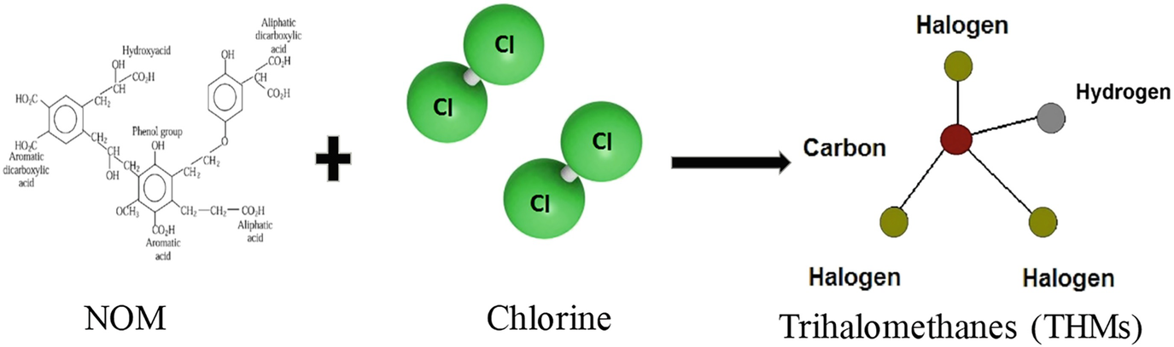
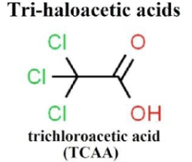
What are disinfection byproducts?
Disinfection byproducts are compounds that are unintentionally created during the drinking water treatment process
Many of them are known to be carcinogens, or capable of causing cancer
There are dozens of DBPs; two common classes of DBPs are trihalomethanes (THMs) and and haloacetic acids (HAAs)
Image credits: Kumari & Gupta (2022) Trihalemethanes (THMs) in Wastewater: Causes and Concerns. Wang et al. (2020) Journal of Hazardous Materials
Notes:
Today, we will focus on the tradeoff that can occur between chlorination, an important step in the water treatment process to remove potentially harmful pathogens, and the formation of disinfection byproducts. Disinfection byproducts, or DBPs, are compounds that are unintentionally created during the drinking water treatment process. Many of them are known to be carcinogens, or capable of causing cancer. There are dozens of different DBP compounds. Two common classes of DBPs are trihalomethanes, pictured on the bottom left of the slight, and haloacetic acids, pictured on the bottom right.

Slide 5
How do disinfection byproducts form?
Disinfection byproducts form when DBP precursors, which can be organic matter or inorganic compounds in drinking water sources, react with chlorine during the disinfection process
Organic matter is derived from living organisms and contains carbon
(Naturally-occurring Organic Matter)
Image credits: Kumari & Gupta (2022) Trihalemethanes (THMs) in Wastewater: Causes and Concerns.
Notes:
Disinfection byproducts form when DBP precursors, which can be organic matter or inorganic compounds in drinking water sources, react with chlorine during the disinfection process. Organic matter is derived from living organisms and contains carbon. Inorganic matter may also contain carbon but is not derived from living organisms. When DBP precursors, such as naturally-occurring organic matter, react with chlorine during the treatment process, DBPs may sometimes form.

Slide 6
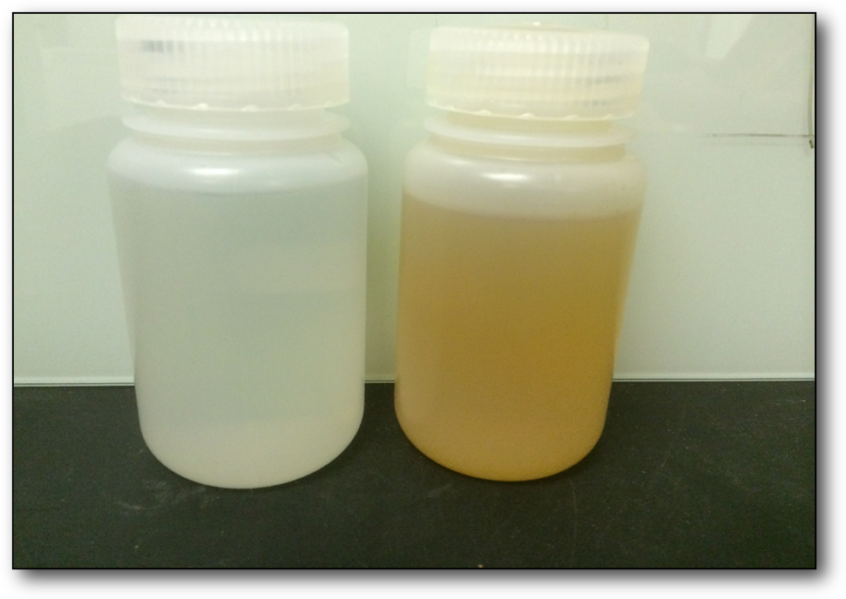
How are DBPs monitored?
Water samples from both plants and distribution systems must be tested for a range of DBPs quarterly
In addition, raw and filtered water are tested once a month for Total Organic Carbon (TOC)
High TOC levels can indicate the presence of DBP precursors which may form DBPs during treatment
Water samples from Falling Creek Reservoir, Vinton, VA
Photo credit: Bethany Bookout
Notes:
DBPs are monitored by water sampling. Once a quarter, water samples from both treatment plants and distribution systems must be tested for a range of DBPs. In addition, raw and filtered water are tested once a month for total organic carbon, or TOC. High TOC levels can indicate the presence of DBP precursors, which may form DBPs during treatment.

Slide 7
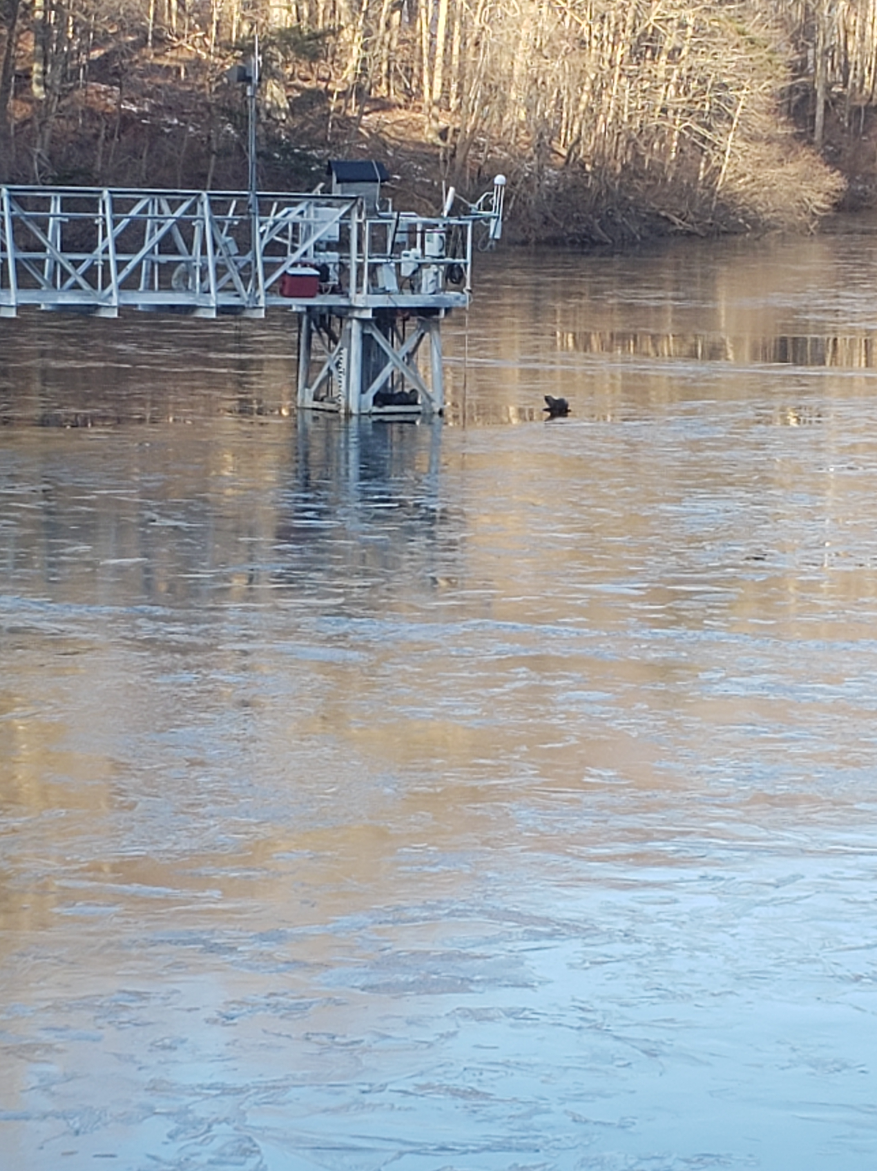
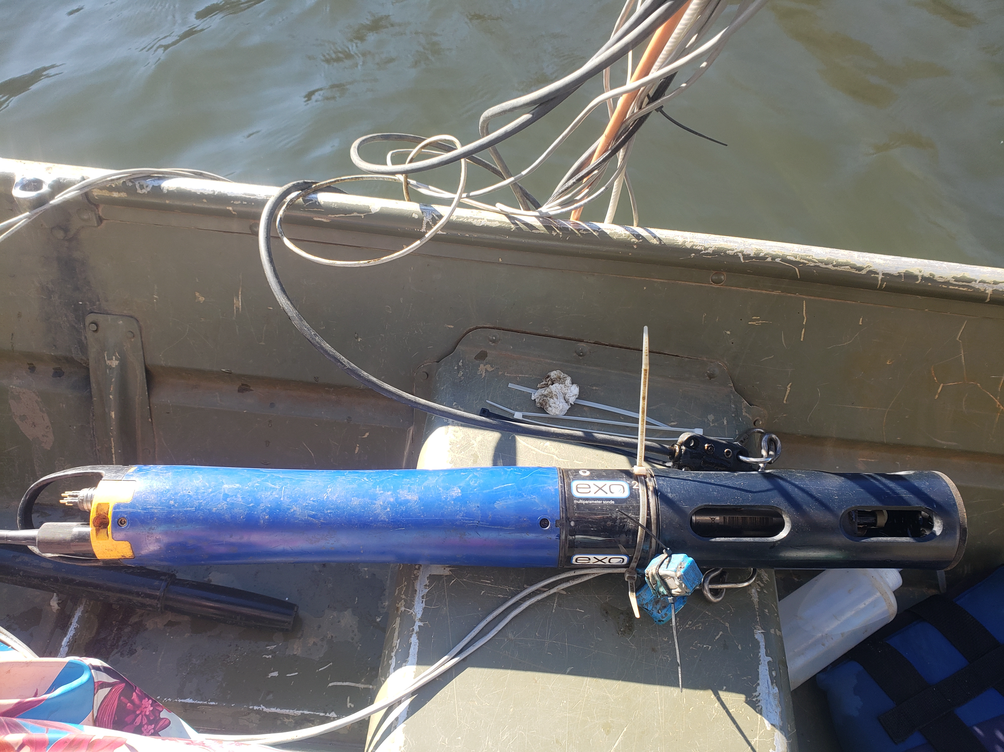
How can environmental data help us avoid the formation of disinfection byproducts?
Some forms of organic matter can be measured using sensors deployed in a drinking water reservoir
We can develop a relationship between these sensor data and total organic carbon (TOC) to determine when DBP precursors might be present
Catwalk
YSI EXO Sensor
Photo credit: Adrienne Breef-Pilz
Notes:
Some forms of organic matter can be measured using sensors deployed in a drinking water reservoir. We can develop a relationship between these sensor data and total organic carbon (TOC) to determine when DBP precursors might be present. If precursors are present, we can adjust treatment processes to mitigate DBP formation risk. In this way, environmental data can help us avoid the formation of disinfection byproducts.

Slide 8
Today…
We are going to explore environmental data from drinking water reservoirs in southwest Virginia, and then use that data to explore tradeoffs in drinking water treatment decisions.
Some of our environmental data are collected using a YSI EXO sensor deployed in a drinking water reservoir.
Catwalk
YSI EXO Sensor
Photo credit: Adrienne Breef-Pilz
Notes:
Today, we are going to explore environmental data from drinking water reservoirs in southwest Virginia, and then use that data to explore tradeoffs in drinking water treatment decisions. For example, some of the data are collected using YSI EXO sensor, which is pictured on the bottom right of the slide. This sensor is deployed at a fixed depth in the reservoir, attached to a catwalk. In this module, you will work with fluorescent dissolved organic matter data collected by this sensor.

Slide 9
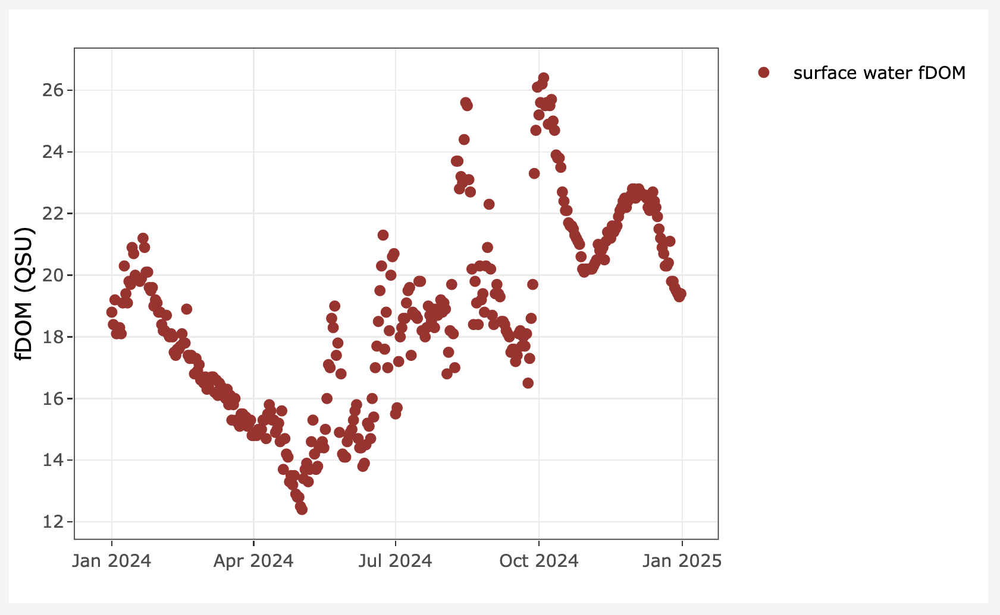

Today…
We are going to explore environmental data from drinking water reservoirs in southwest Virginia, and then use that data to explore tradeoffs in drinking water treatment decisions.
We will explore fDOM (fluorescent dissolved organic matter) data as an indicator of TOC and possible DBP precursors.
The color in coffee is an example of dissolved organic matter.
Photo credit: Wikipedia
Notes:
fDOM stands for fluorescent dissolved organic matter. Characteristics of fDOM are: 1) it is derived from living things (like tree leaves or phytoplankton) and contain carbon; 2) fDOM compounds are not particles, but are dissolved in the water; 3) if light is transmitted through the water, these fDOM compounds will emit their own light in response through the process of fluorescence. One everyday example of dissolved organic matter are the coffee compounds that dissolve from the coffee grounds into the water and turn the coffee brown. fDOM is measured using sensors that transmit light at a particular wavelength through the water and then measure how much light is emitted from the fluorescent organic matter compounds in return. Because it is a form of organic matter, the presence of fDOM can also indicate that DBP precursors are present. Thus, higher fDOM may mean an increased risk of DBP formation during the treatment process.

Slide 10

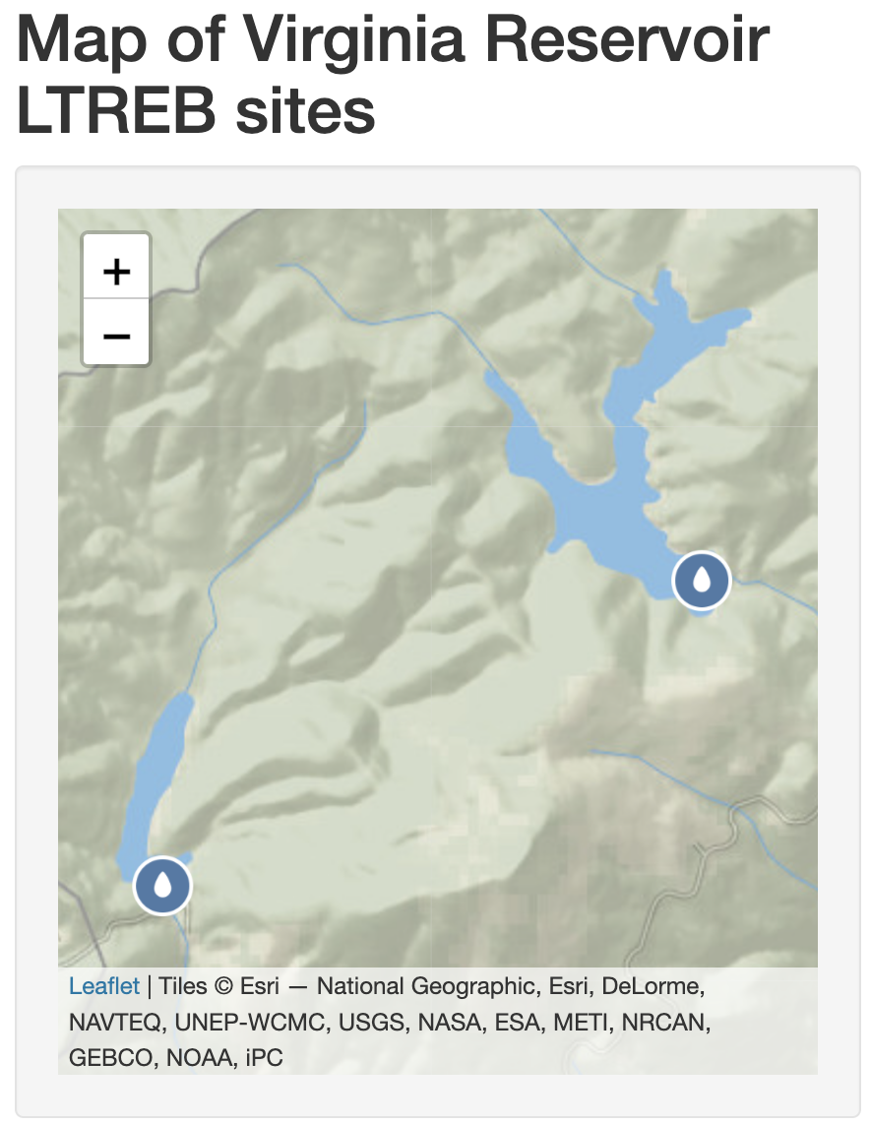
Today…
We are going to explore environmental data from drinking water reservoirs in southwest Virginia, and then use that data to explore tradeoffs in drinking water treatment decisions.
We will explore data from Falling Creek Reservoir and Beaverdam Reservoir in Vinton, VA.
Notes:
You will have the option to explore fDOM data from one of two reservoirs located in southwest Virginia: Falling Creek Reservoir or Beaverdam Reservoir. Both reservoirs are located in Vinton, Va, near Roanoke, and are owned and operated by the Western Virginia Water Authority as drinking water supply reservoirs.

Slide 11
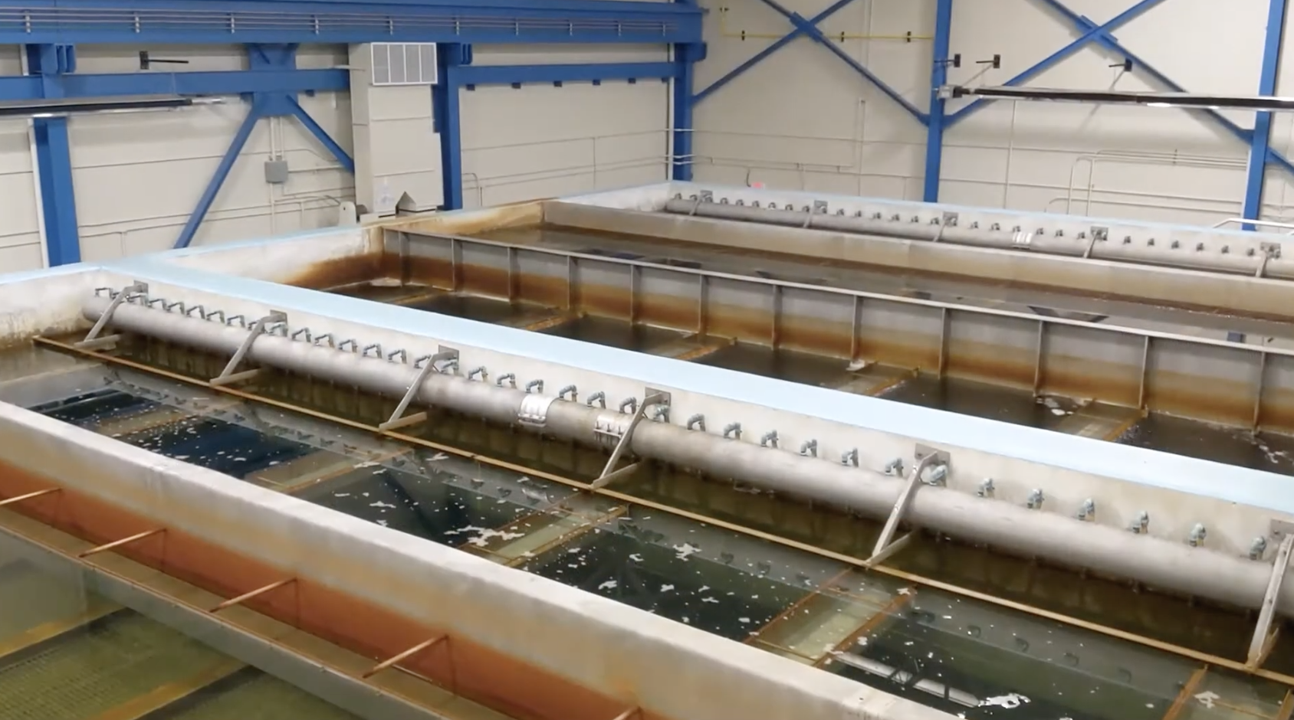
Today…
We are going to explore environmental data from drinking water reservoirs in southwest Virginia, and then use that data to explore tradeoffs in drinking water treatment decisions.
We will use environmental data to inform decisions about drinking water treatment to optimize for both disinfection and avoiding byproduct formation.
Spring Hollow Reservoir Treatment Plant
Photo credit: Western Virginia Water Authority
Notes:
You will use high-frequency fDOM data from your chosen reservoir to assess the risk of DBP formation and make water treatment plant operation decisions. In Activity B, you will convert fDOM to total organic carbon to assess when DBP formation is most likely in your reservoir. In Activity C, you will complete a drinking water reservoir case study and view fDOM data from different times of year in a reservoir. Then, you will decide whether to enact additional treatment measures to avoid DBP formation during the treatment process.

Slide 12
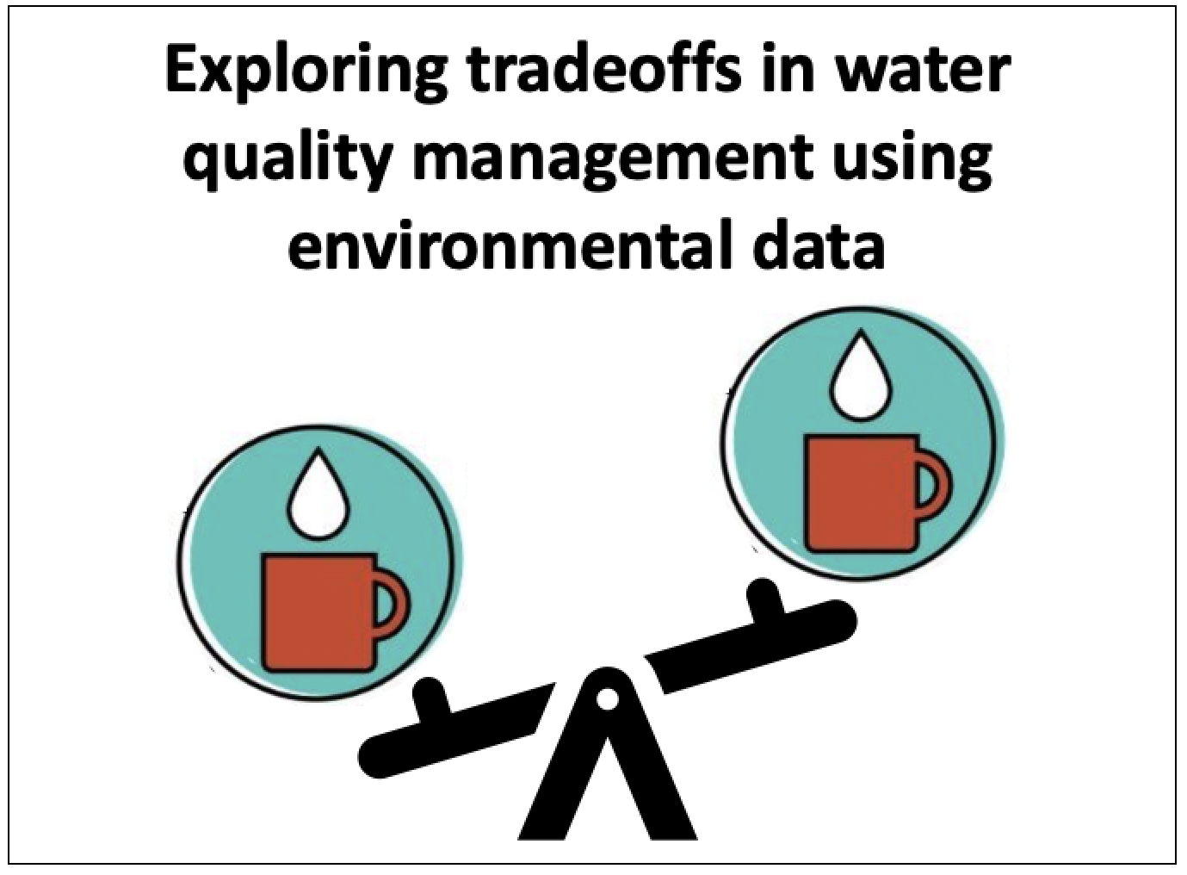
Learning objectives of today’s module:
Define what disinfection byproducts are
Describe the environmental and water treatment processes that influence the formation of disinfection byproducts
Understand the trade-offs between disinfection and byproduct formation that can occur when chlorinating water, and treatment techniques that can be used to manage these tradeoffs (e.g., coagulation, activated carbon filters)
Use environmental data visualizations to identify when additional treatment techniques to avoid disinfection byproduct formation should be used to meet water quality objectives
Notes:
This module has four learning objectives (read objectives).

Slide 13
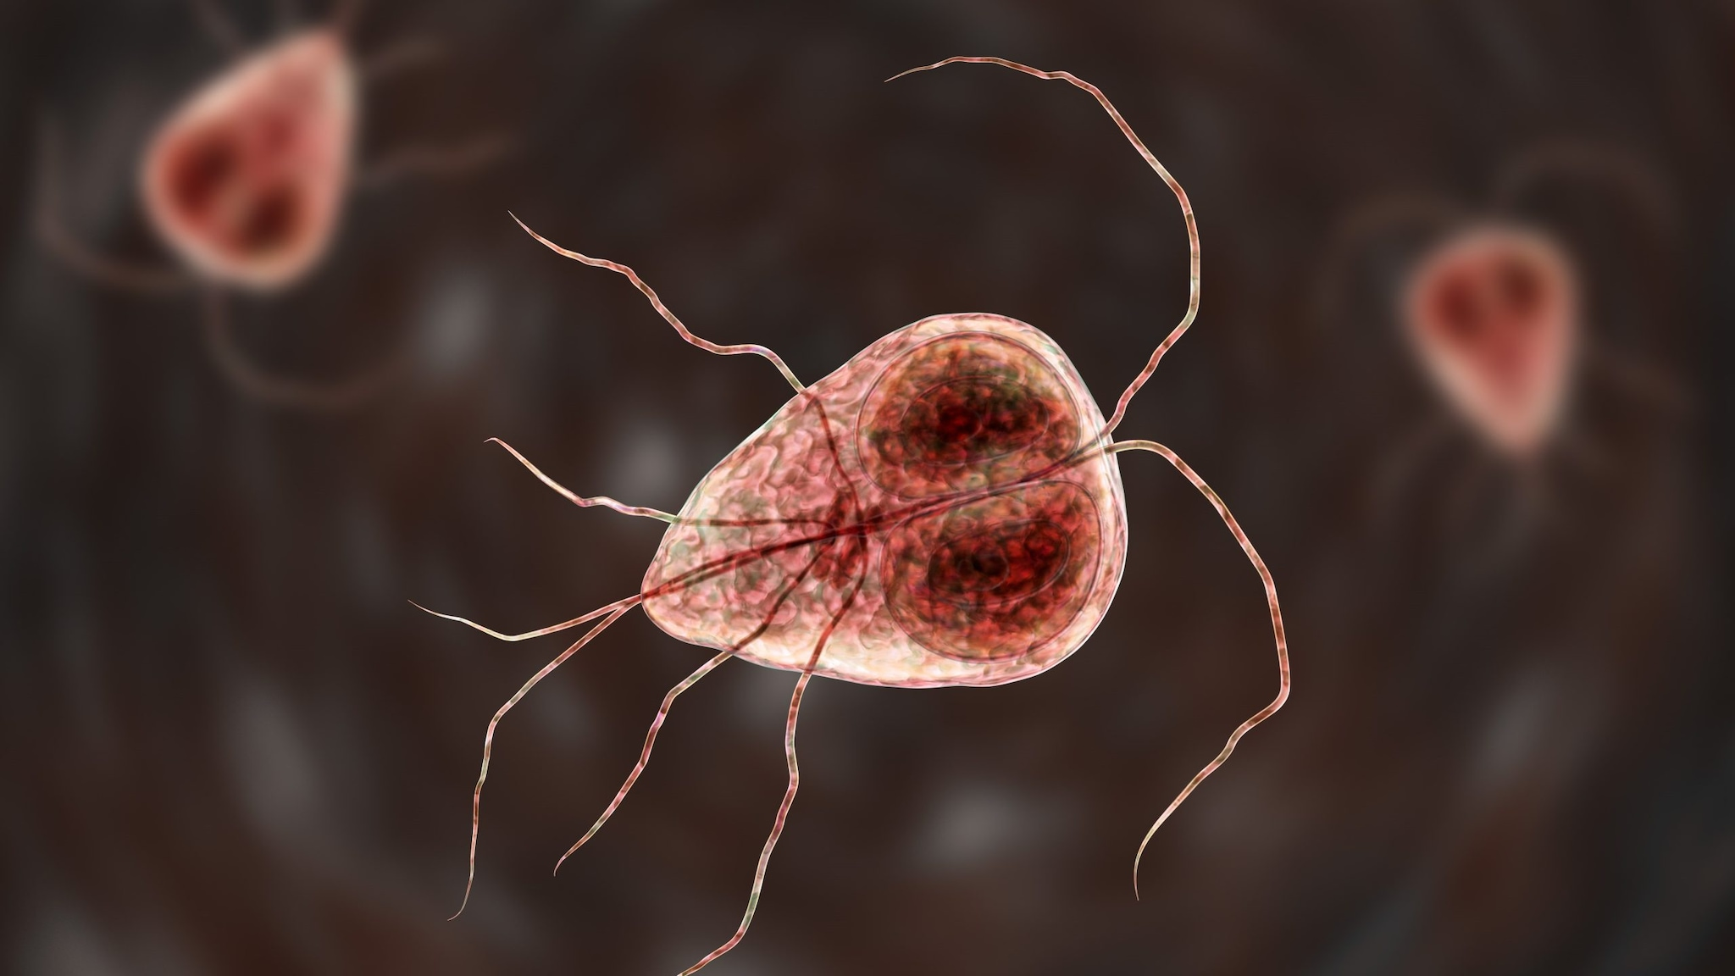
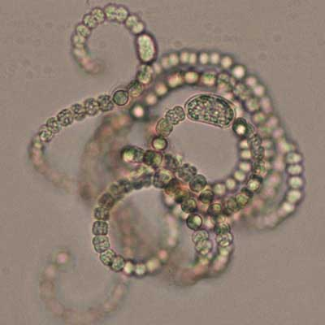
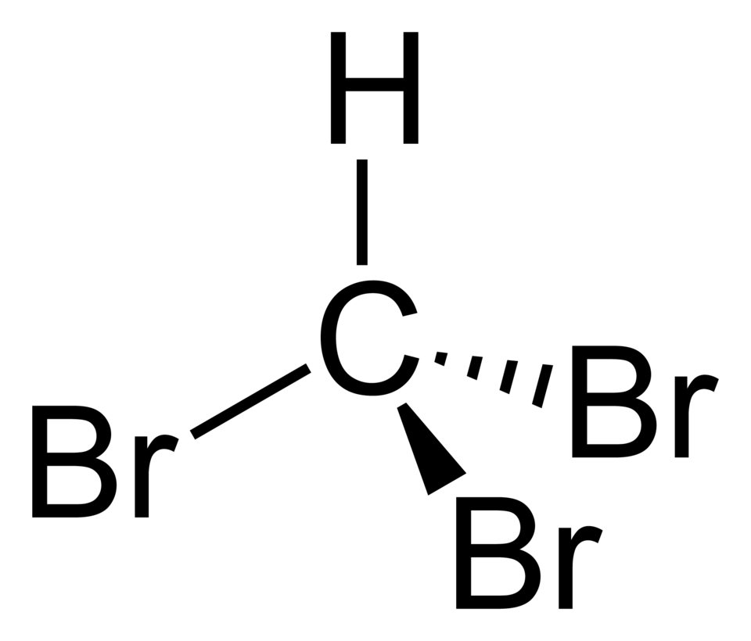
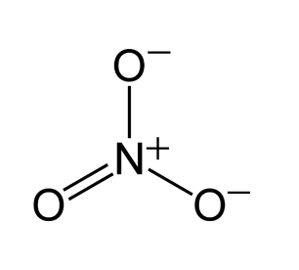
Activity A: Explore how disinfection byproducts are formed
Objective 1: Understand factors affecting DBP formation and drinking water thresholds for DBPs
Objective 2: Explore tradeoffs in disinfection vs. DBP formation
Image sources:
Bromoform - https://commons.wikimedia.org/wiki/File:Bromoform-2D.png
Phytoplankton - https://coastalscience.noaa.gov/monitoring-and-assessments/pmn/image-gallery/freshwater-plankton-gallery/
Nitrate molecule - https://en.wikipedia.org/wiki/Nitrate#/media/File:Nitrate-ion-resonance-2D.png
Giardia - https://www.cdc.gov/giardia/about/index.html
Notes:
I will now give a brief overview of the module activities. In Activity A, you will complete two objectives. First, you will learn about factors affecting DBP formation and drinking water thresholds for DBPs. Second, you will explore tradeoffs in disinfection vs. DBP formation.

Slide 14
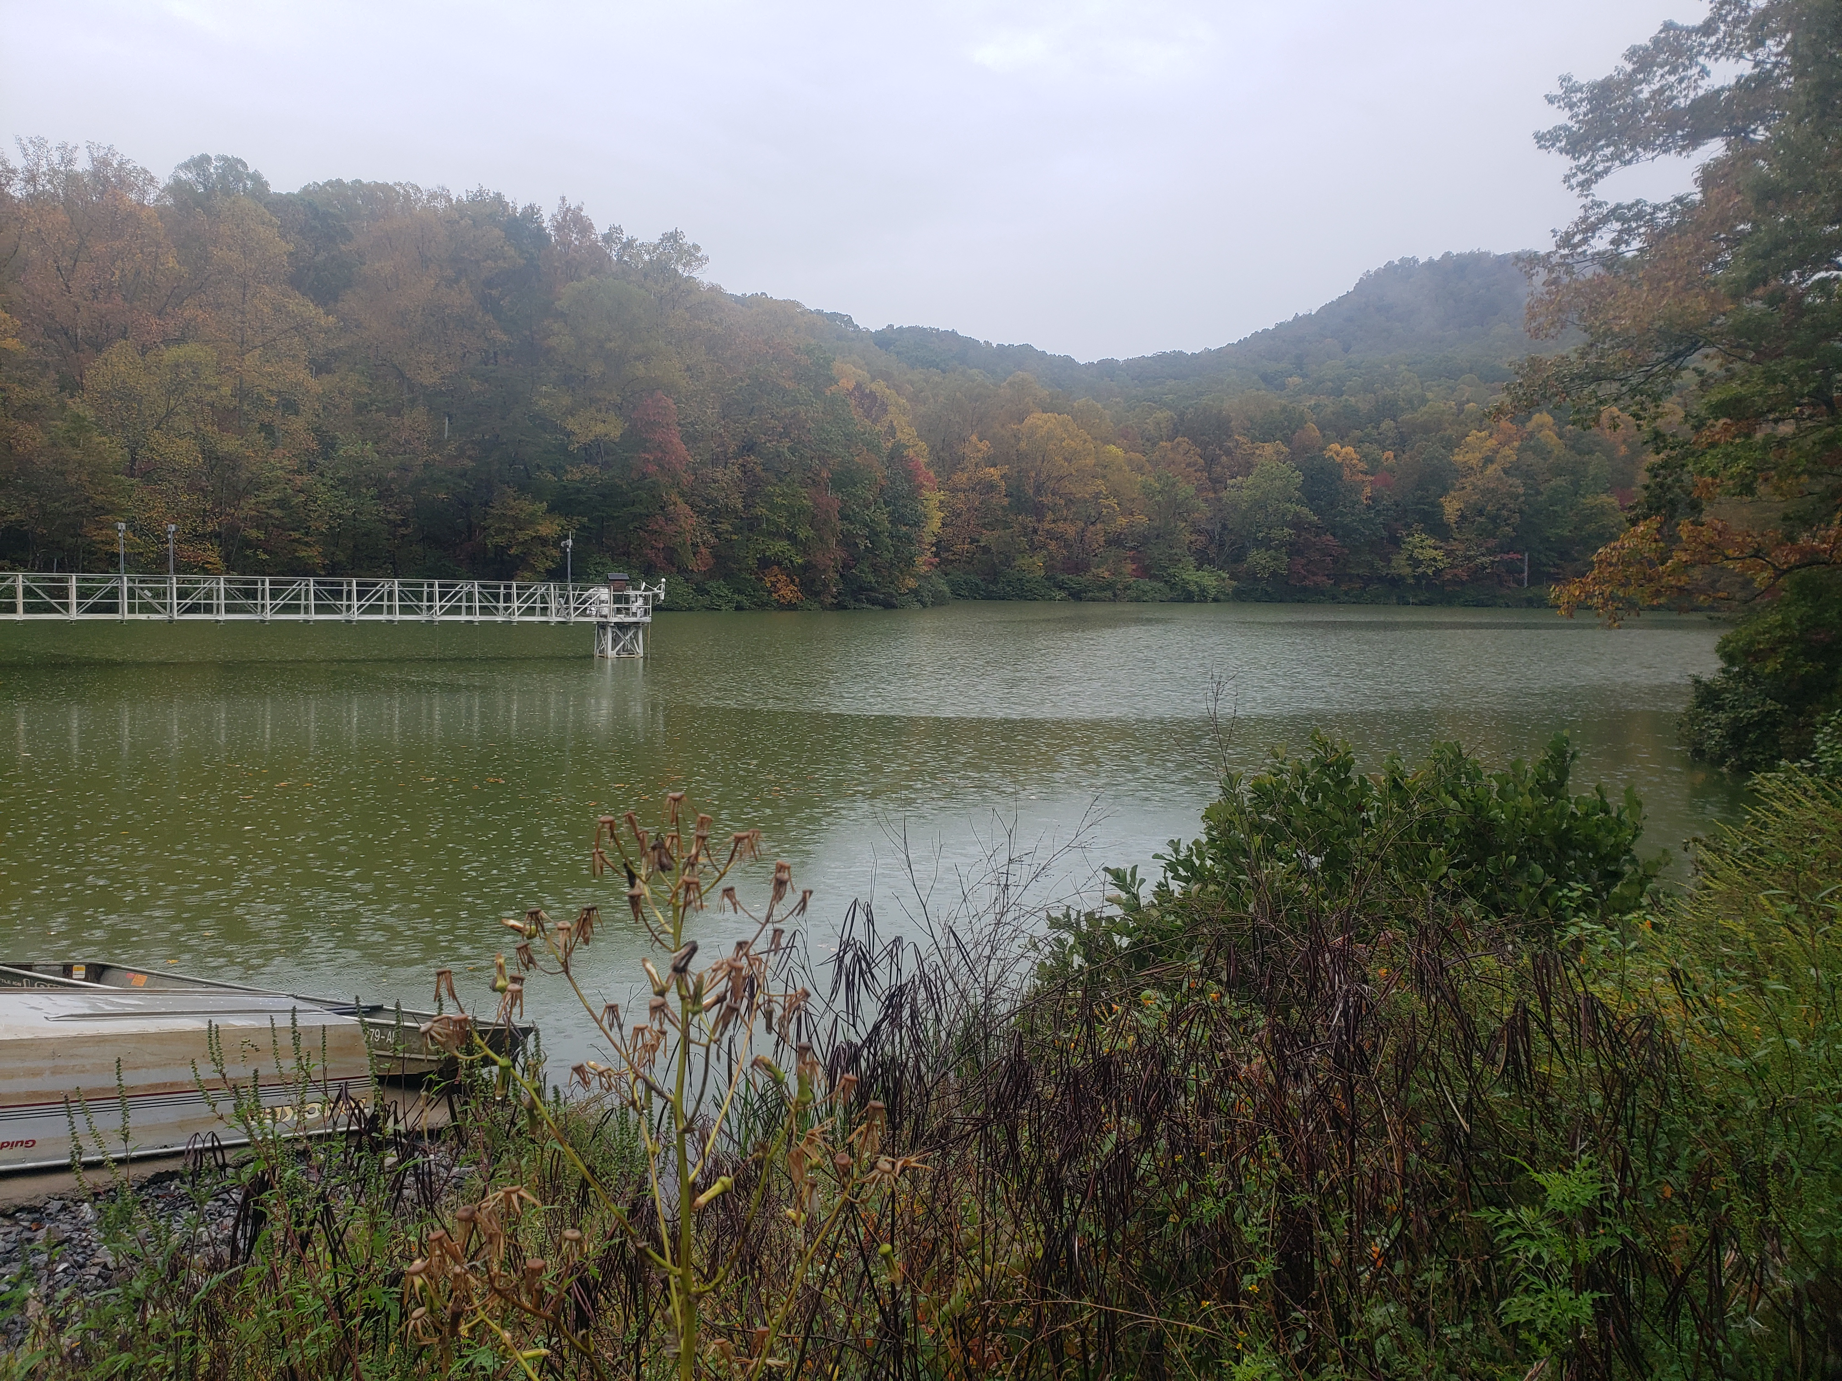
Activity B: Explore environmental data that can indicate the presence of DBP precursors
Objective 3: Learn about your focal drinking water reservoir
Objective 4: View and interpret organic matter data from your focal reservoir
Falling Creek Reservoir, Vinton, VA, USA
Photo credit: Adrienne Breef-Pilz
Notes:
In Activity B, you will learn more about the focal drinking water reservoir that you select to work with during the module. Then, you will view and interpret organic matter data from your focal reservoir.

Slide 15
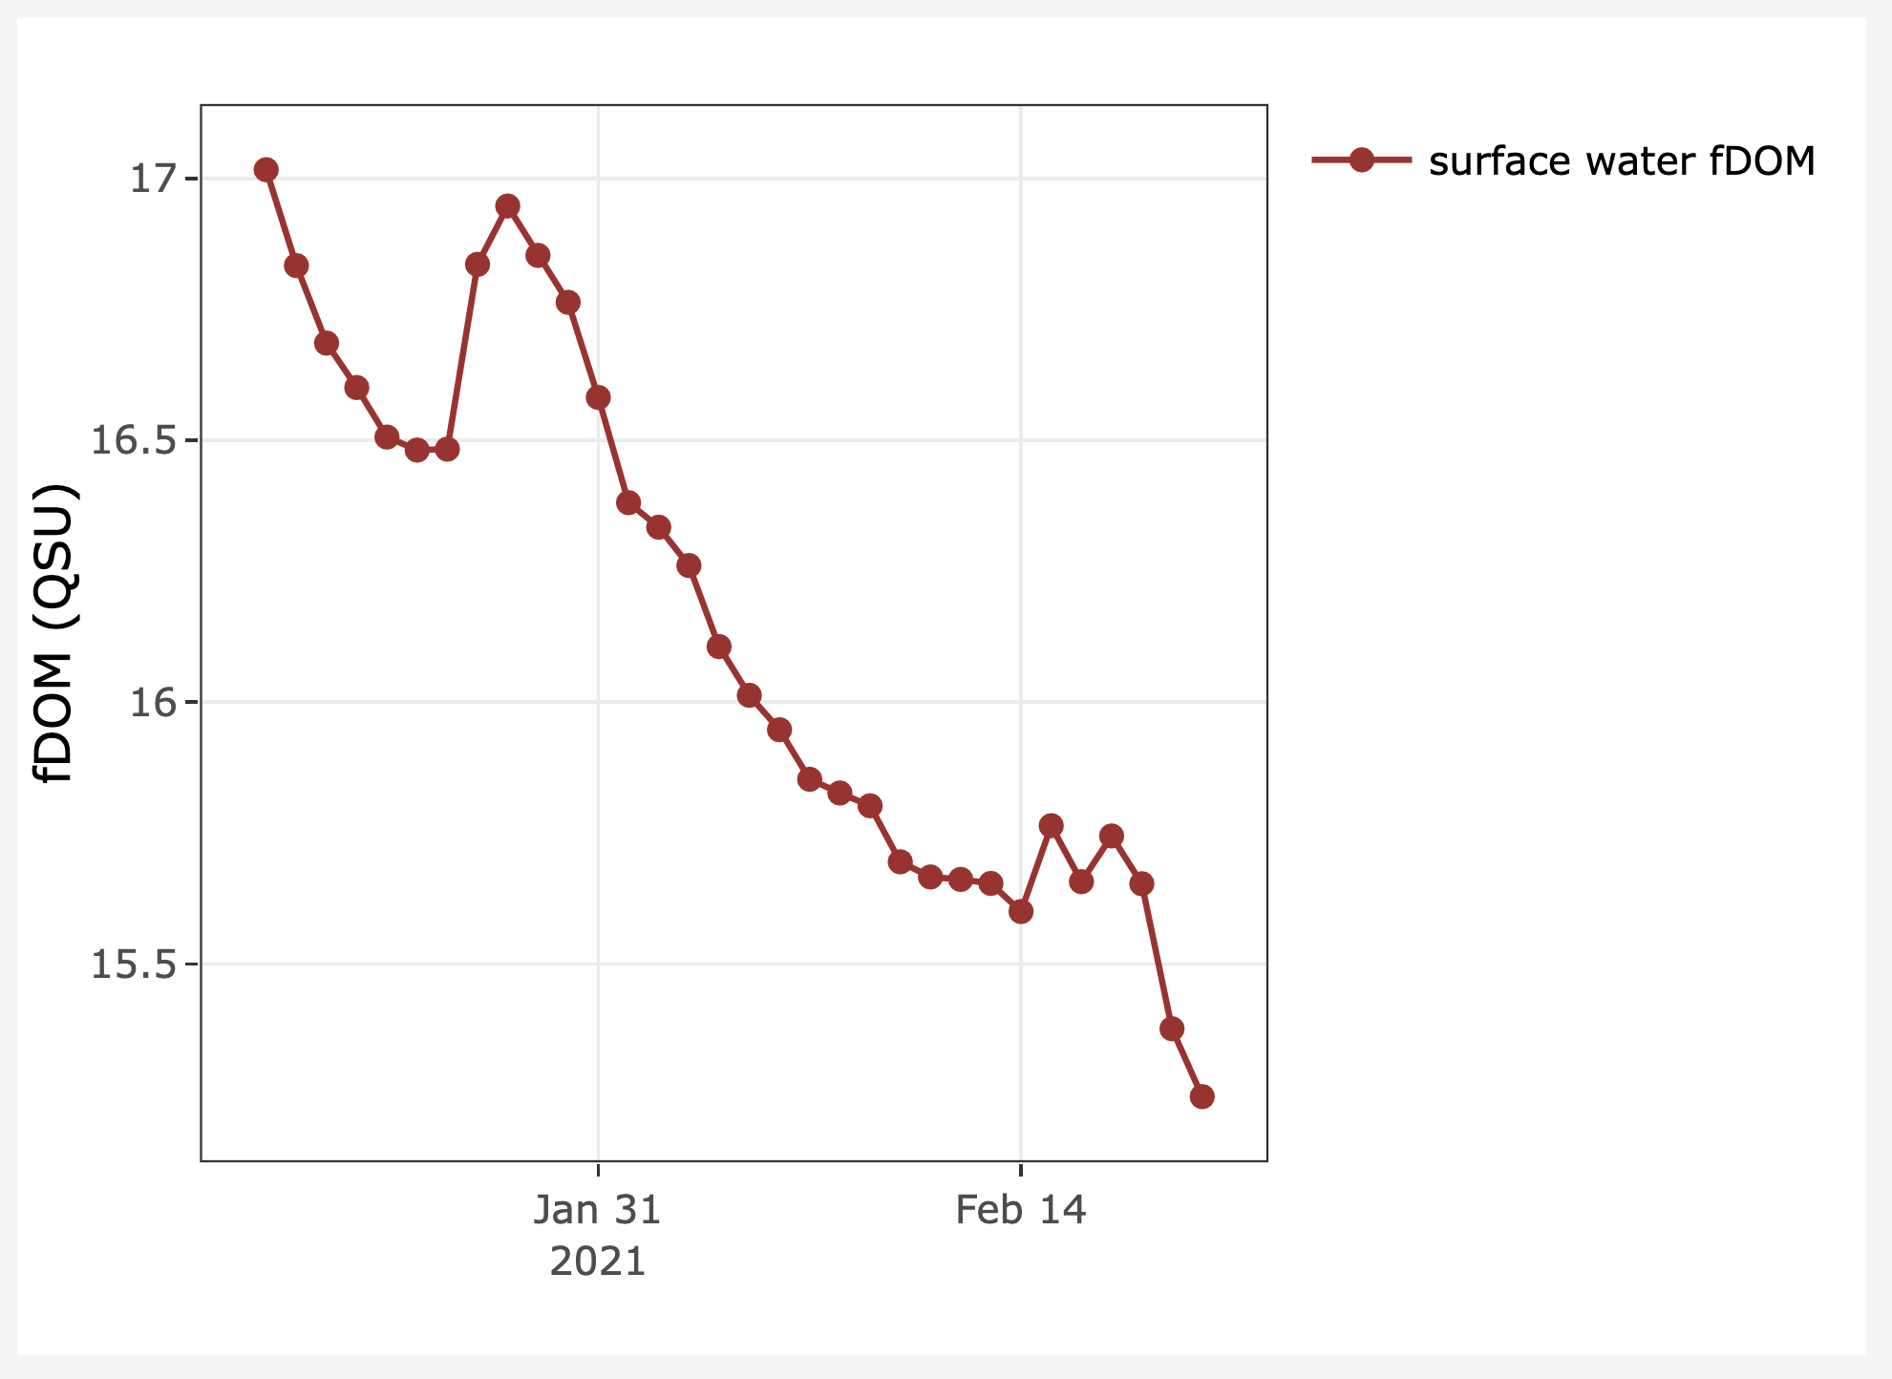
Activity C: Use environmental data to inform water treatment decisions
Objective 5: Use organic matter data to make water treatment decisions
Notes:
In Activity C, students will complete a scenario which asks them to make water treatment decisions using organic matter data.

Slide 16


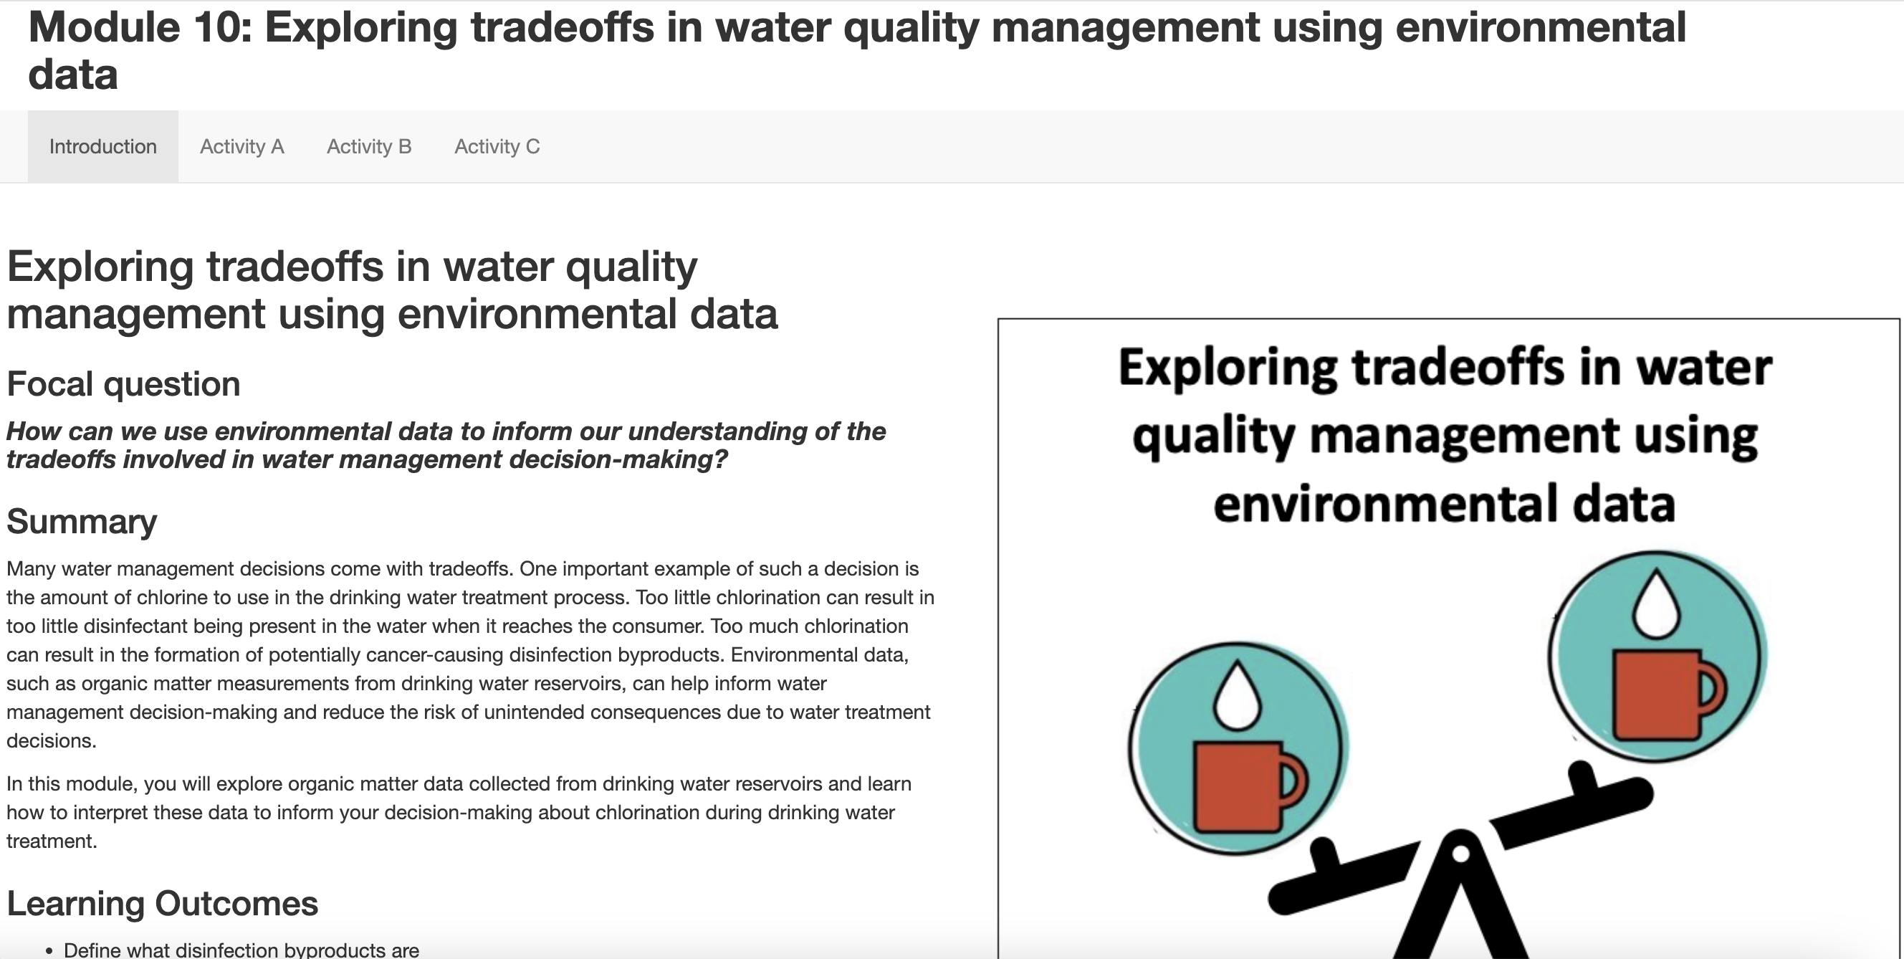
Canvas + Shiny App
The module can be accessed through your course Canvas site
You will complete module activities in an R Shiny app, which is an interactive website
Be sure to complete the ”Quick-start” guide to the module and watch the video that explains the interactive module features
Questions are embedded in the app and you will answer these in a Canvas quiz
Notes:
The module can be accessed through your course Canvas site
You will complete module activities in an R Shiny app, which is an interactive website
Be sure to complete the ”Quick-start” guide to the module and watch the video that explains the interactive module features
Questions are embedded in the app and you will answer these in a Canvas quiz

Slide 17
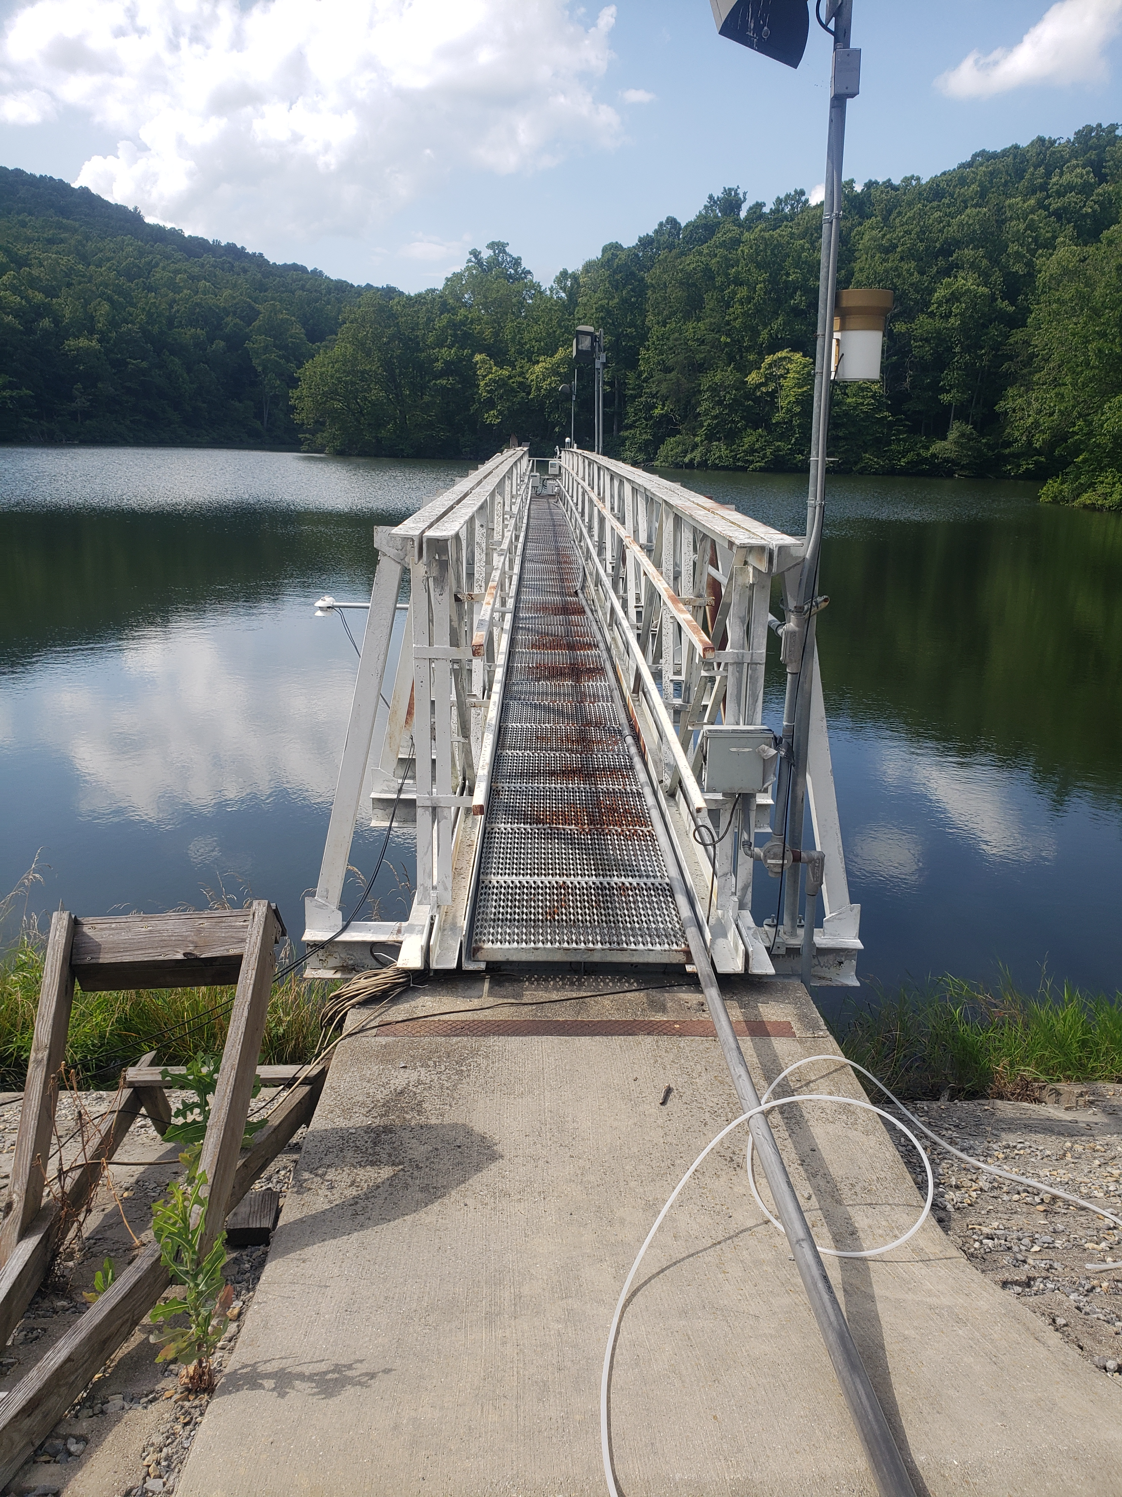
Thank you for participating!
Check out our other water quality & management modules:
Module 8: Using Ecological Forecasts to Guide Decision Making
Module 9: Using High-Frequency Data to Manage Water Quality
Find out more at: macrosystemsEDDIE.org
Notes:
Thank you for participating!

